Slide 1

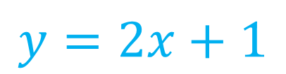


Algebra Interactive Notebook
$$3ab$$
$$\frac{5xy}{6}$$
Name :
Class :
Term 1 Semester 1
$$2x+3y$$
$$y=2x+1$$

Slide 2
Contents
Glossary
Page
Date
Description
2
3

Slide 3
Tasks
24
7
30
Essential Question
Questions
Notes
Summary
4
7

Slide 4
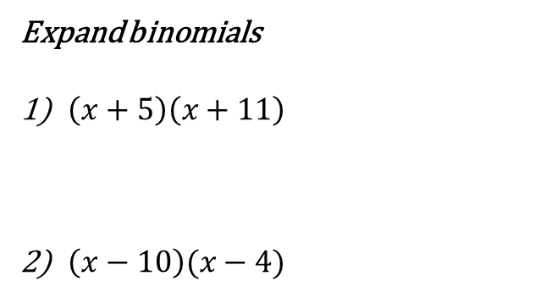
revision
Expand binomials
$\left(x+5\right)\left(x+11\right)$
$\left(x−10\right)(x−4)$

Slide 5
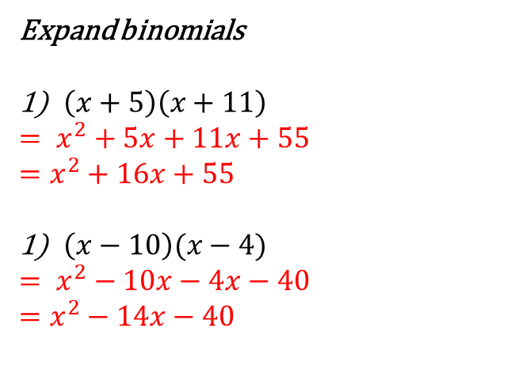
revision
Expand binomials
$\left(x+5\right)\left(x+11\right)$
$= x^{2}+5x+11x+55$
$=x^{2}+16x+55$
$\left(x−10\right)(x−4)$
$= x^{2}−10x−4x−40$
$=x^{2}−14x−40$

Slide 6
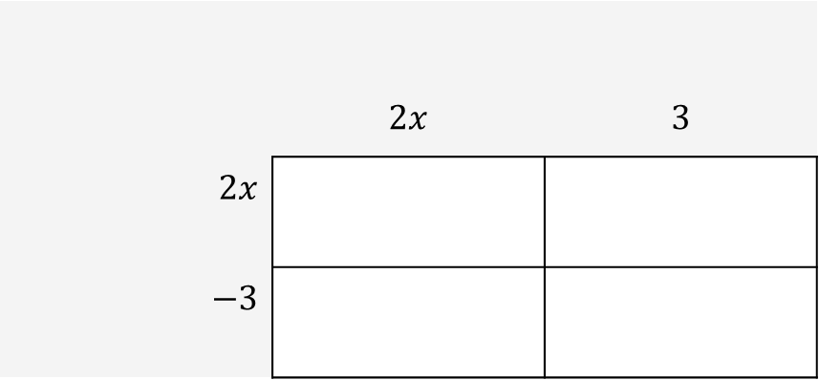
Expanding binomials
24
7
30
EQ: How do I expand binomial products?
How do I expand binomials?
$$\left(2x+3\right) (2x−3)$$
 | $$2x$$ | $$3$$
$2x$
$−3$

Slide 7
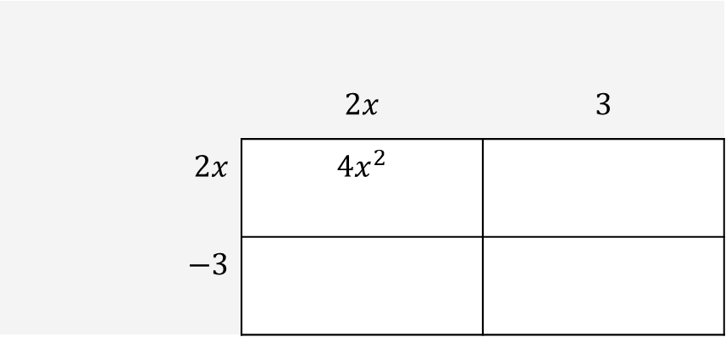
Expanding binomials
24
7
30
EQ: How do I expand binomial products?
How do I expand binomials?
$$\left(2x+3\right) (2x−3)$$
 | $$2x$$ | $$3$$
$2x$ | $${4x}^{2}$$
$−3$

Slide 8
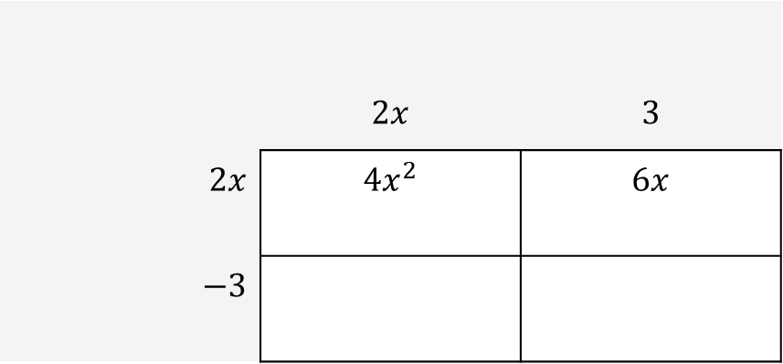
Expanding binomials
24
7
30
EQ: How do I expand binomial products?
How do I expand binomials?
$$\left(2x+3\right) (2x−3)$$
 | $$2x$$ | $$3$$
$2x$ | $${4x}^{2}$$ | $$6x$$
$−3$

Slide 9
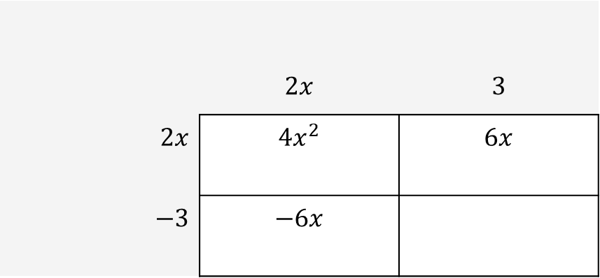
Expanding binomials
24
7
30
EQ: How do I expand binomial products?
How do I expand binomials?
$$\left(2x+3\right) (2x−3)$$
 | $$2x$$ | $$3$$
$2x$ | $${4x}^{2}$$ | $$6x$$
$−3$ | $$−6x$$

Slide 10
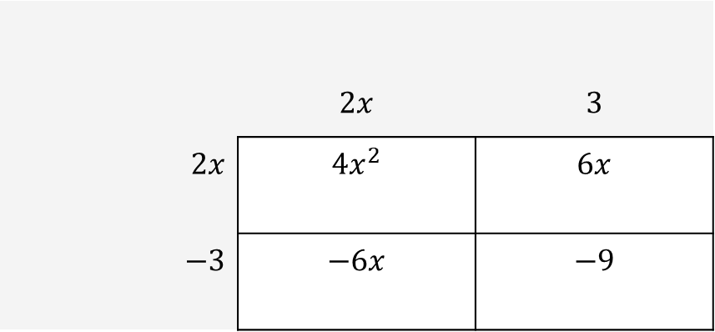
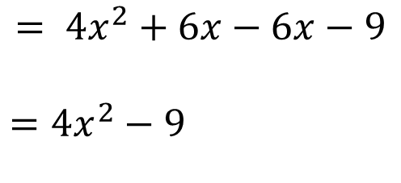
Expanding binomials
24
7
30
EQ: How do I expand binomial products?
How do I expand binomials?
$$\left(2x+3\right) (2x−3)$$
 | $$2x$$ | $$3$$
$2x$ | $${4x}^{2}$$ | $$6x$$
$−3$ | $$−6x$$ | $$−9$$
$$= {4x}^{2}+6x−6x−9$$
$={4x}^{2}−9$

Slide 11
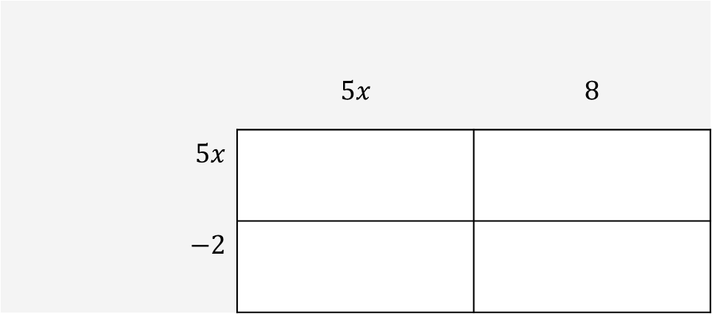

WE do
$$(5x+8)(5x−8)$$
 | $$5x$$ | $$8$$
$5x$
$−2$

Slide 12

you do
$$(4x+5)(2x −4)$$

Slide 13
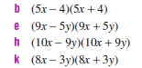
practice

Slide 14
Questions:
https://play.kahoot.it/#/k/6570041a-94cb-4887-bbdd-72f0f334ffe8
Kahoot quiz

